Slide 1


University of and MathWorks Present: Machine Learning Onramp

Slide 2
Today:
6:15 pm – 6.30 pm: Set-up
Intro to Machine Learning
Create MathWorks account
Log in to Machine Learning Onramp / Test MATLAB Online
6.30 pm – 8.00 pm: Machine Learning Onramp (on your own)

Slide 3
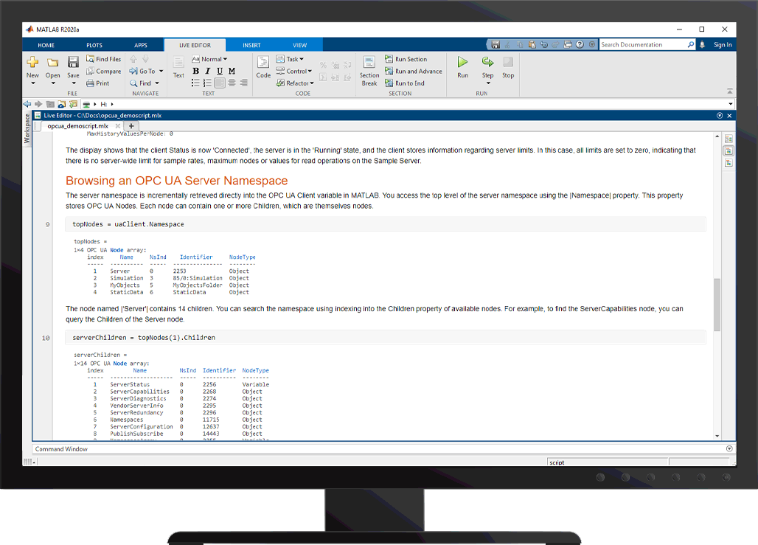
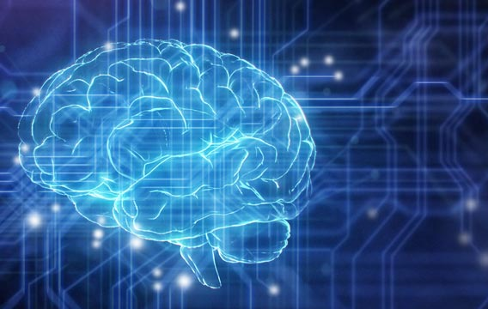
What is Machine Learning?
Process in which a computer uses statistics to find patterns within data sets
The patterns found can be used to classify future data sets
Machine learning at work:
Unlocking a phone with facial or fingerprint recognition
Video streaming sites recommending similar videos
Social media filters knowing where faces are in a frame

Slide 4
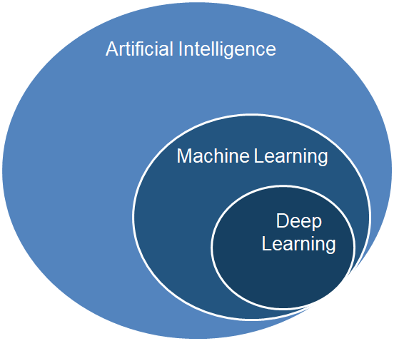
MATLAB for Artificial Intelligence
Machine Learning
Deep Learning
Reinforcement Learning
Predictive Maintenance
Data Science / Data Analytics
Signal Processing
Image Processing
…and more
Notes:
The purpose of this slide is to show the landscape of MATLAB tools that the broad term “AI” covers. MATLAB has tools for all of these domains and more. Machine Learning is more than just one “toolbox”.

Slide 5

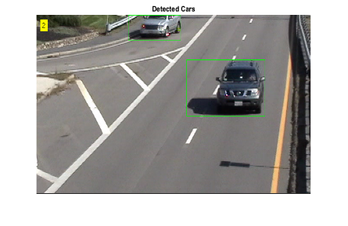
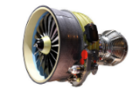
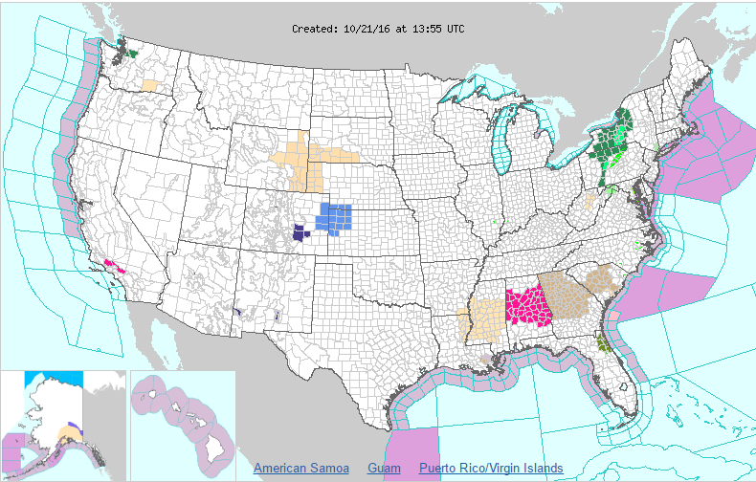
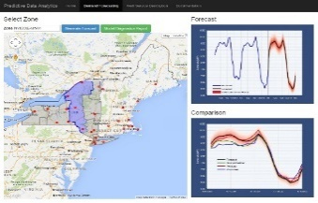
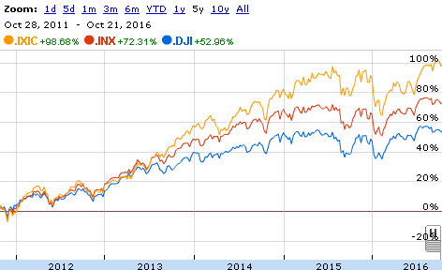
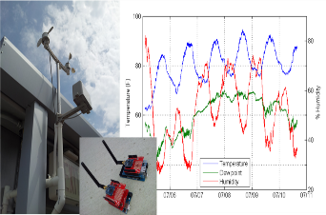
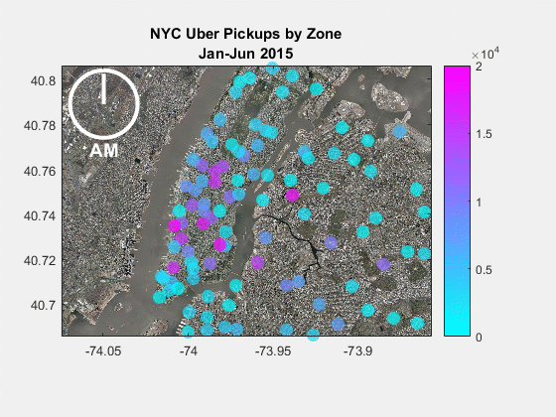
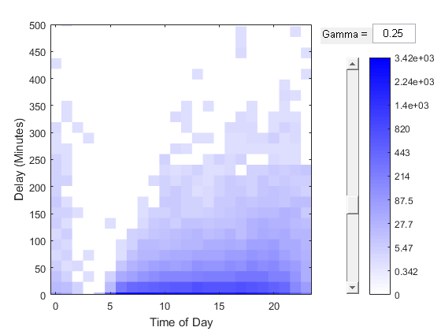
Machine Learning is Everywhere
Solution is too complex for hand written rules or equations
learn complex non-linear relationships
Speech Recognition
Object Recognition
Engine Health Monitoring
Solution needs to adapt with changing data
update as more data becomes available
Weather Forecasting
Energy Load Forecasting
Stock Market Prediction
Solution needs to scale
learn efficiently from very large data sets
IoT Analytics
Taxi Availability
Airline Flight Delays
Notes:
Machine learning has become quite pervasive today. Here are some examples of applications where machine learning has enabled performance that would have been very difficult to achieve with traditional modeling techniques.
Lets take a look at the characteristics of these problems that make them such a good fit for machine learning techniques.
Problems such as speech recognition, object recognition and engine health monitoring are too complex for hand written rules or equations. Machine learning algorithms are designed to learn such complex non-linear relationships.
Weather forecasting, energy load forecasting and stock market prediction are examples of applications where the underlying system is constantly changing so the solution also needs to change and adapt. Machine learning algorithms can quickly learn from new data and thus keep up with such dynamic systems.
Applications like IoT analytics, taxi availability analysis and airline flight delay prediction typically involve learning from large amounts of data. Machine learning algorithms are designed to learn efficiently from such large datasets.

Slide 6
Different Types of Machine Learning
Type of Learning
Categories of Algorithms
Classification
Output is a choice between classes
(True, False) (Red, Blue, Green)
Supervised Learning
Regression
Output is a real number (temperature, stock prices).
Develop predictive model based on both input and output data
Machine Learning
Unsupervised Learning
Clustering
Discover a good internal representation
Learn a low dimensional representation
Group and interpret data based only on input data
Notes:
Machine learning can be branched into unsupervised learning and supervised learning. In case of unsupervised learning, you can group your data based on some similarity/characteristic. This is known as clustering. You do not necessarily need to have known groupings before clustering.
In case of supervised learning, one creates a model to predict a quantity of interest. We will call it output or response variable. You have an expectation of what factors (called inputs/predictors) will have an impact on response, even though you may not have an understanding of the exact relationship. You would use the predictors and response data to train your model and use the model to make predictions, given only the input data.
If your response is discreet in nature, for instance, if you are trying to predict tumor size into small, medium, large, then it is a classification problem.
If your response is continuous in nature, for instance, if you are trying to predict electricity demand from a grid (in kW-hrs), then it is a regression problem.
Machine Learning are terms that are used interchangeably.

Slide 7
Different Types of Machine Learning
Type of Learning
Categories of Algorithms
Classification
Decision Trees, Nearest Neighbor, Support Vector Machines, Ensemble Methods, Discriminant Analysis
Supervised Learning
Regression
Linear Regression, Generalized Linear Regression, Nonlinear Regression, Mixed-Effects, Stepwise, Gaussian Process Regression
Develop predictive model based on both input and output data
Machine Learning
Unsupervised Learning
Clustering
k-means, k-medoids, Hierarchical, Gaussian Mixture Models, Nearest Neighbors, Hidden Markov Models
Group and interpret data based only on input data
Notes:
Machine learning can be branched into unsupervised learning and supervised learning. In case of unsupervised learning, you can group your data based on some similarity/characteristic. This is known as clustering. You do not necessarily need to have known groupings before clustering.
In case of supervised learning, one creates a model to predict a quantity of interest. We will call it output or response variable. You have an expectation of what factors (called inputs/predictors) will have an impact on response, even though you may not have an understanding of the exact relationship. You would use the predictors and response data to train your model and use the model to make predictions, given only the input data.
If your response is discreet in nature, for instance, if you are trying to predict tumor size into small, medium, large, then it is a classification problem.
If your response is continuous in nature, for instance, if you are trying to predict electricity demand from a grid (in kW-hrs), then it is a regression problem.
Machine Learning are terms that are used interchangeably.

Slide 8
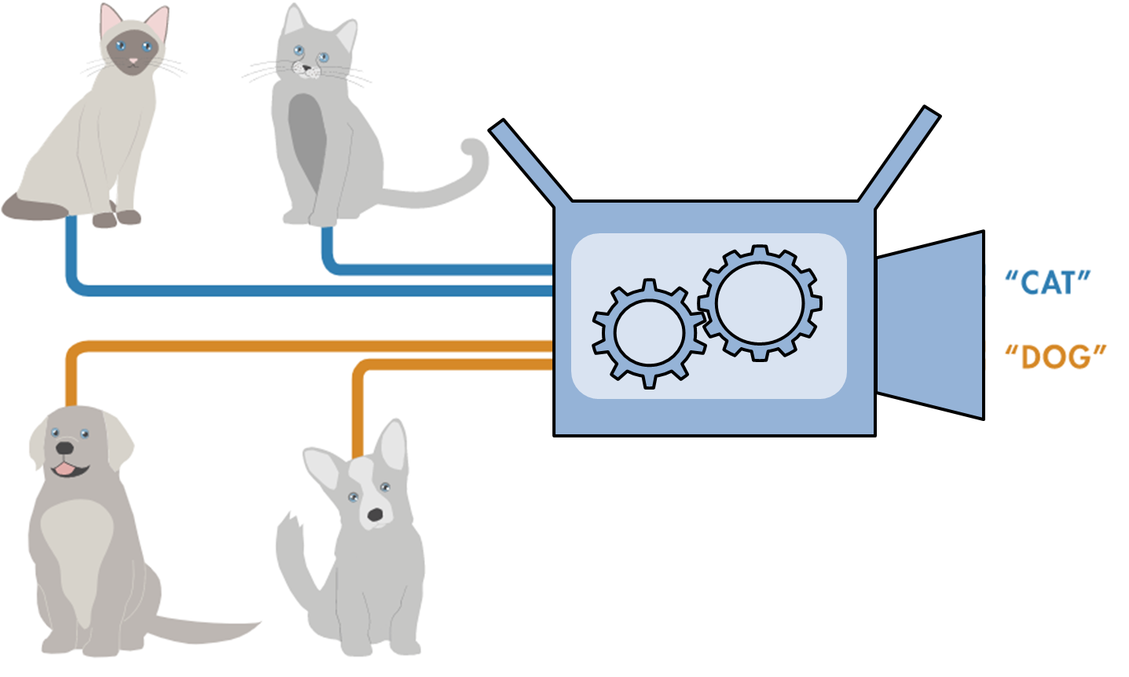
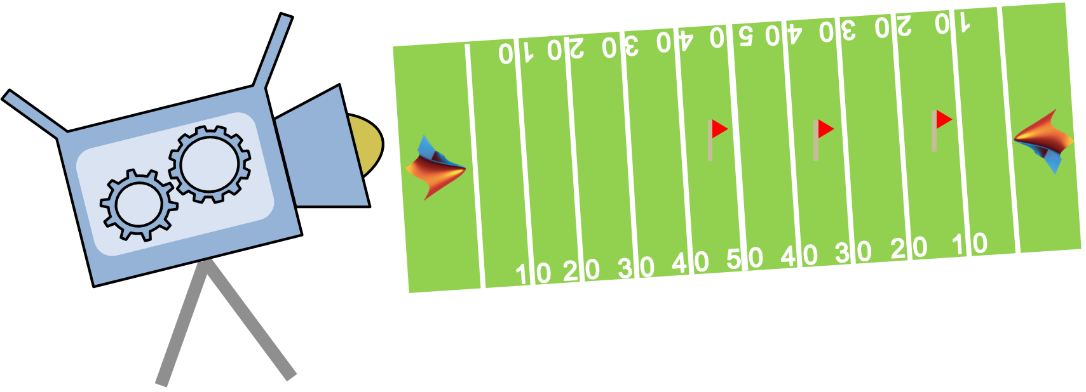
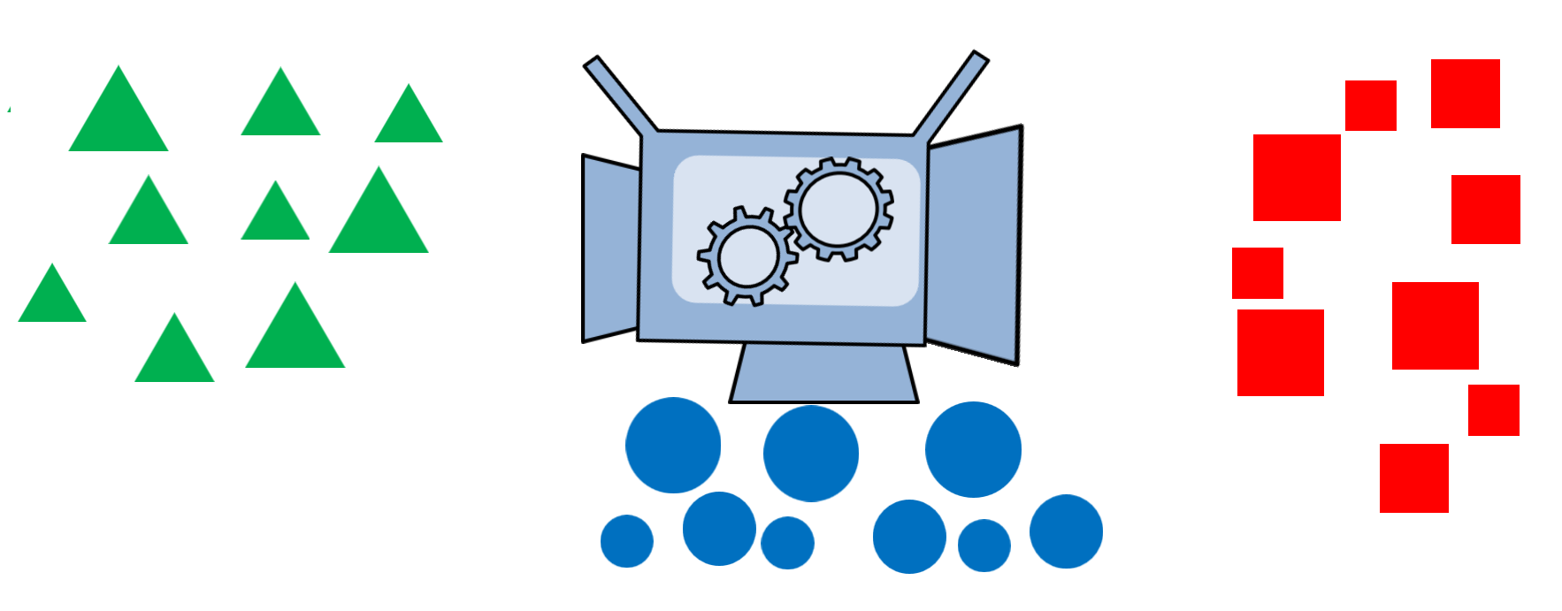
Different Types of Machine Learning
Type of Learning
Categories of Algorithms
Classification
Supervised Learning
Regression
Develop predictive model based on both input and output data
Machine Learning
Unsupervised Learning
Clustering
Group and interpret data based only on input data
Notes:
Machine learning can be branched into unsupervised learning and supervised learning. In case of unsupervised learning, you can group your data based on some similarity/characteristic. This is known as clustering. You do not necessarily need to have known groupings before clustering.
In case of supervised learning, one creates a model to predict a quantity of interest. We will call it output or response variable. You have an expectation of what factors (called inputs/predictors) will have an impact on response, even though you may not have an understanding of the exact relationship. You would use the predictors and response data to train your model and use the model to make predictions, given only the input data.
If your response is discreet in nature, for instance, if you are trying to predict tumor size into small, medium, large, then it is a classification problem.
If your response is continuous in nature, for instance, if you are trying to predict electricity demand from a grid (in kW-hrs), then it is a regression problem.
Machine Learning are terms that are used interchangeably.

Slide 9
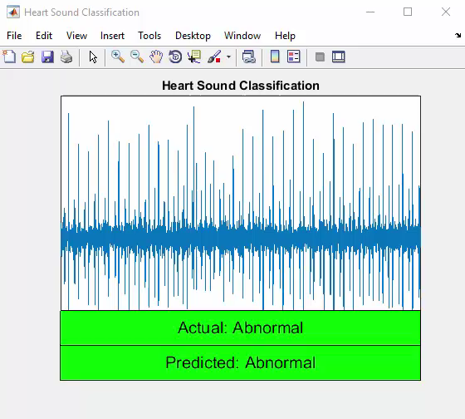
Example: Heart Sound Classification
Motivation
Heart sounds are complex signals
Require trained clinicians for diagnosis
Goal: build a classifier and deploy in portable device
Data: Heart sound recordings (phonocardiogram):
From PhysioNet Challenge 2016
5 to 120 seconds long audio recordings
Normal
Heart Sound Recording
Classification Algorithm
Abnormal
Notes:
Q: How long ago did your doctor last hear your heart with a stethoscope?
Maybe long ago, because in US easy access to advanced diagnostic tools, but not so in Bangladesh or Brazil’s Amazon
-> STILL a very useful diagnostic technique, but requires a trained clinician, which aren’t always available (not 24x7 even in US, not at all in underdeveloped countries)
To make the screening available without having a clinician, our objective is to develop an algorithm that can be used for automatic classification of heart sounds and deployed in a small portable diagnostic device.
JOKE: to demonstrate, now I need a volunteer whose heart sounds I can check with our prototype device here
CLICK to show app
Our actual prototype runs through some heart sound recordings from the validation set and shows the prediction along with the actual diagnosis (normal/abnormal) waveform
CLICK to run through video
First step in the workflow is getting the data…. Here we use a dataset made available by PhysioNet in a competition they hosted in 2016.
Next let’s remind ourselves of the rest of the workflow to develop machine learning applications

Slide 10
Different Types of Machine Learning
A 4-min Video on Types of ML
Type of Learning
Categories of Algorithms
Classification
Supervised Learning
Regression
Develop predictive model based on both input and output data
Machine Learning
Unsupervised Learning
Clustering
Group and interpret data based only on input data
Notes:
Machine learning can be branched into unsupervised learning and supervised learning. In case of unsupervised learning, you can group your data based on some similarity/characteristic. This is known as clustering. You do not necessarily need to have known groupings before clustering.
In case of supervised learning, one creates a model to predict a quantity of interest. We will call it output or response variable. You have an expectation of what factors (called inputs/predictors) will have an impact on response, even though you may not have an understanding of the exact relationship. You would use the predictors and response data to train your model and use the model to make predictions, given only the input data.
If your response is discreet in nature, for instance, if you are trying to predict tumor size into small, medium, large, then it is a classification problem.
If your response is continuous in nature, for instance, if you are trying to predict electricity demand from a grid (in kW-hrs), then it is a regression problem.
Machine Learning are terms that are used interchangeably.

Slide 11
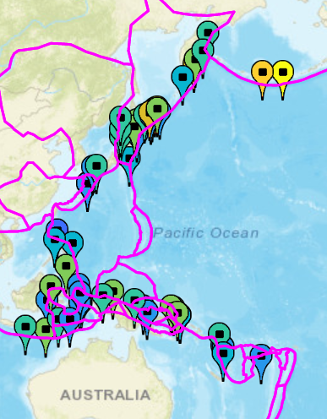
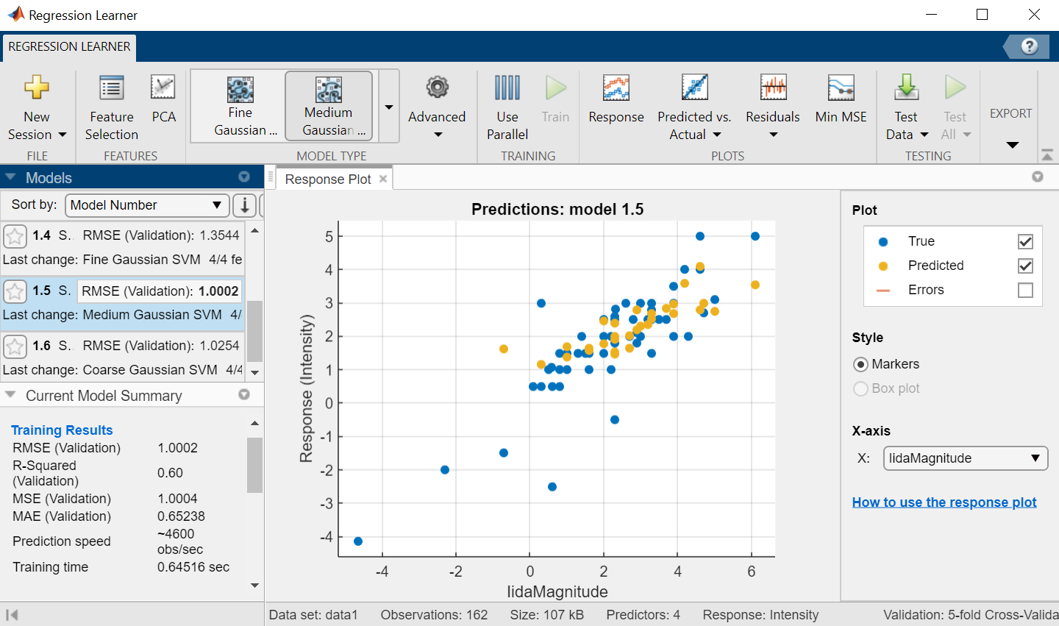
Regression: Prediction of tsunami intensity
Goal: Study predictors of tsunami
Explore data and build initial models
Don’t need to be a regression expert
Approach:
Load data in MATLAB
Use interactive tools and Mapping Toolbox for data visualization
Use the Regression Learner App to run multiple regression algorithms
Create a model which can predict tsunami intensity for a new set of predictors
Convert live scripts into reports
Notes:
To demonstrate the data science workflow, we will be importing numeric data to predict tsunami intensity using machine learning. We will do this with the help of a regression learner app.

Slide 12
Different Types of Machine Learning
A 4-min Video on Types of ML
Type of Learning
Categories of Algorithms
Classification
Supervised Learning
Regression
Develop predictive model based on both input and output data
Machine Learning
Unsupervised Learning
Clustering
Group and interpret data based only on input data
Notes:
Machine learning can be branched into unsupervised learning and supervised learning. In case of unsupervised learning, you can group your data based on some similarity/characteristic. This is known as clustering. You do not necessarily need to have known groupings before clustering.
In case of supervised learning, one creates a model to predict a quantity of interest. We will call it output or response variable. You have an expectation of what factors (called inputs/predictors) will have an impact on response, even though you may not have an understanding of the exact relationship. You would use the predictors and response data to train your model and use the model to make predictions, given only the input data.
If your response is discreet in nature, for instance, if you are trying to predict tumor size into small, medium, large, then it is a classification problem.
If your response is continuous in nature, for instance, if you are trying to predict electricity demand from a grid (in kW-hrs), then it is a regression problem.
Machine Learning are terms that are used interchangeably.

Slide 13
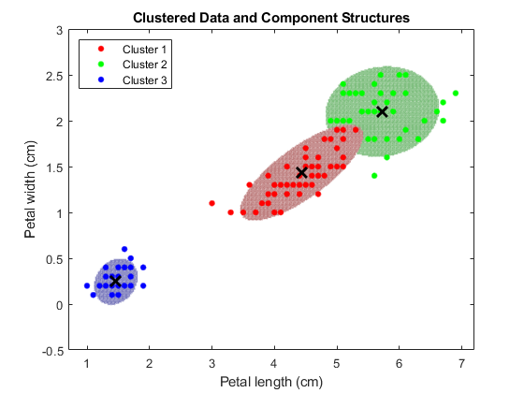
Clustering
Segment data into groups based on similarity
Identify outliers
Discover patterns of interest
Variety of algorithms
k-means, k-medoids, Hierarchical, Gaussian Mixture Models, Nearest Neighbors, Hidden Markov Models
Iterative process

Slide 14

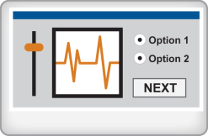
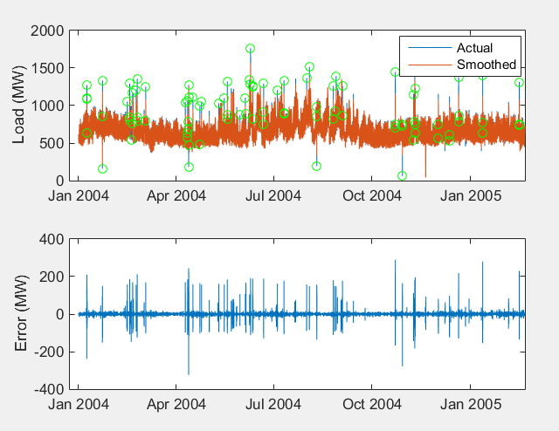
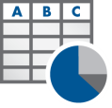


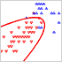
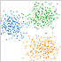
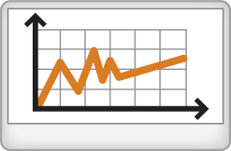


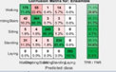










Machine Learning Workflow
Access and Explore Data
Preprocess Data
Develop Predictive Models
Integrate Analytics with Systems
Files
Working with
Messy Data
Model Creation e.g. Machine Learning
Desktop Apps
Databases
Data Reduction/
Transformation
Parameter Optimization
Enterprise Scale Systems
Sensors
Feature
Extraction
Model
Validation
Embedded Devices and Hardware

Slide 15
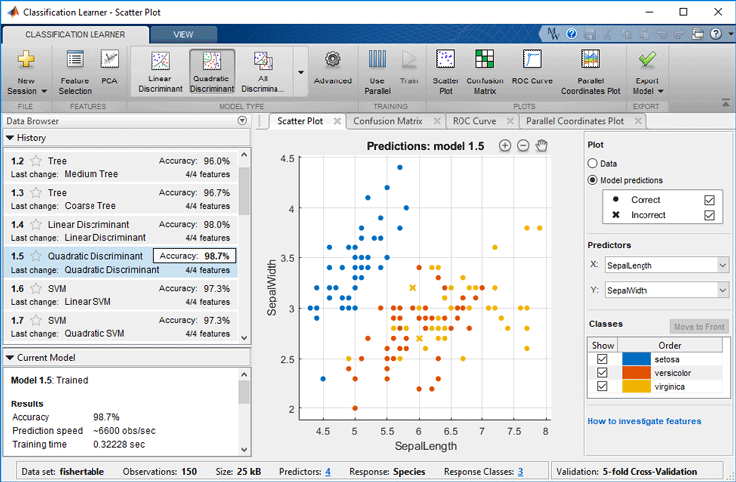
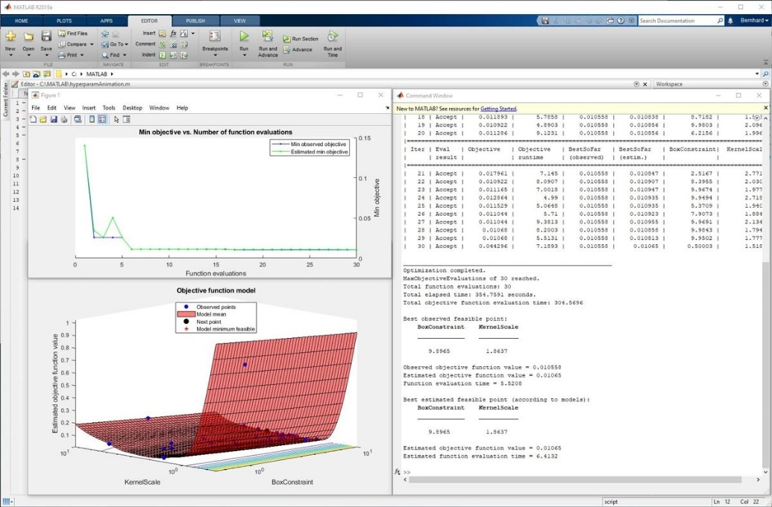
Machine learning with MATLAB
Choose from popular machine learning algorithms, train models, tune and export all interactively
Generate and embed C/C++ code for machine learning algorithms
Speed up statistical computations and model training with parallel computing
Use tall arrays to train machine learning models on data sets too large to fit in machine memory

Slide 16
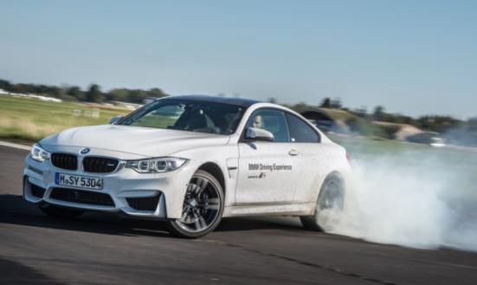
BMW Uses Machine Learning to Detect Oversteering
Challenge
Develop automated software for detecting oversteering, an unsafe condition in which rear tires lose their grip during a turn
Solution
Use MATLAB to develop, train, and evaluate a variety of supervised machine learning classifier types, including KNN, SVM, and decision trees
Results
Oversteering identified with greater than 98% accuracy
Multiple machine learning classifiers trained automatically
Code generated and deployed to an ECU for real-time, in-vehicle testing
A BMW M4 oversteering on a test track.
Link to article

Slide 17
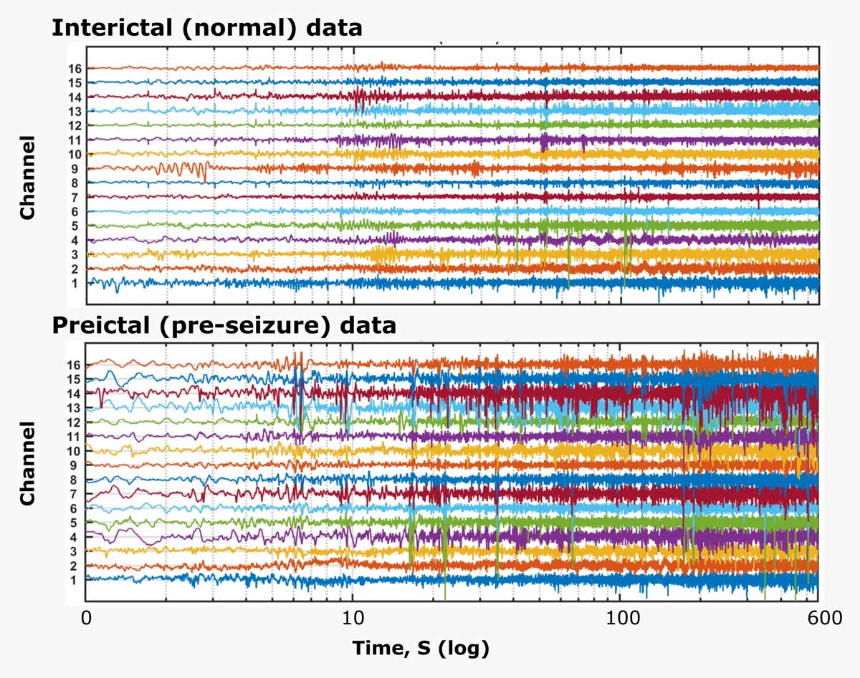
University College of London Researcher Uses Machine Learning to Predict Epileptic Seizures from EEG Data
Challenge
Develop algorithms that can predict the onset of epileptic seizures based on human intracranial electroencephalograph (EEG) recordings
Solution
Use MATLAB to extract features from the data, identify the best classification models, and combine models to maximize prediction accuracy
Results
Created model for predicting epileptic seizure for multiple patients
Developed algorithms that won first place for individual participants and third place overall in a worldwide Kaggle competition
Halved computation time by simultaneously processing training and test data on multiple cores
Intracranial EEG data analyzed with machine learning algorithms
Link to article

Slide 18
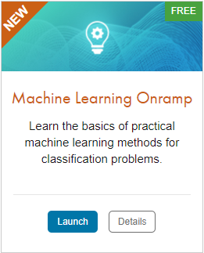
TO DO
Go to https://matlabacademy.mathworks.com/
Log in to your MathWorks account
Launch Machine Learning Onramp

Slide 19
Additional Learning Resources:
Follow @matlab_students on Instagram for tips/tricks, videos, and more!
This account is managed by MathWorks and is specifically for students!
Star the Awesome MATLAB Student Repository on GitHub and Bookmark the MATLAB & Simulink Resources for Students page.
Check out some of the other Student Program opportunities at MathWorks.

